Slide 1


Computer and Information Security (TC2027)

Slide 2

Unit 1 - Cyber Security Foundation
Goals
Why we need computer security?
Main security concepts
Concepts of Confidentiality, Integrity, and Availability (CIA)
Attack Surface & Attack Tree (Graph)
Security Design Principals
Risk Management Foundations

Slide 3
Why we need computer security?

Slide 4
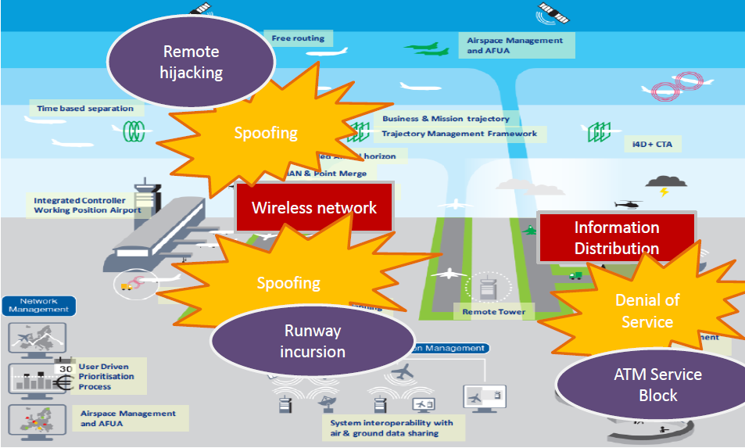
How does produce an attack into the Air Traffic Management System?

Slide 5
How to produce an attack into the Air Traffic Management System?
There are a set of attack vectors to produce the consequence;
Requires deep knowledge to produces; and
Requires an unusual chain of failures.

Slide 6
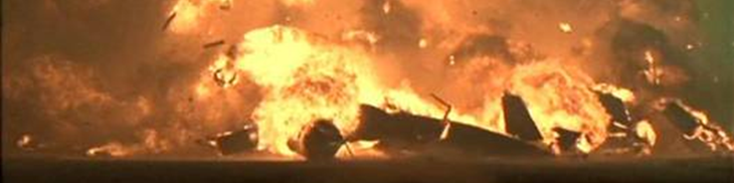
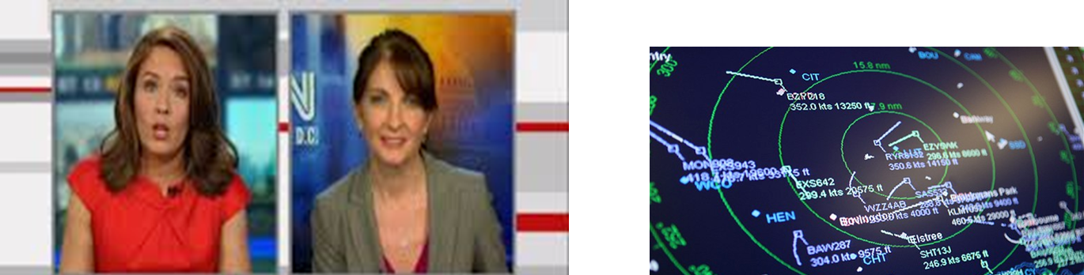
However, if the attack occurs, the consequences can be catastrophic and irrecoverable!

Slide 7
Ukraine Power Grid Cyberattack Autopsy
23 December 2015

Slide 8
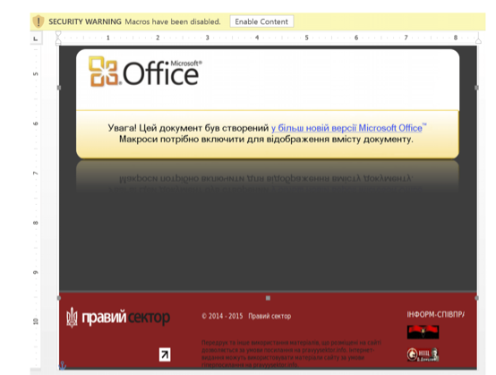
Ukraine Power Grid Cyberattack
A very sophisticated attack, based on a set of different steps with different exploit techniques;
However, the first step uses the infection of Microsoft Office documents through infected emails.

Slide 9
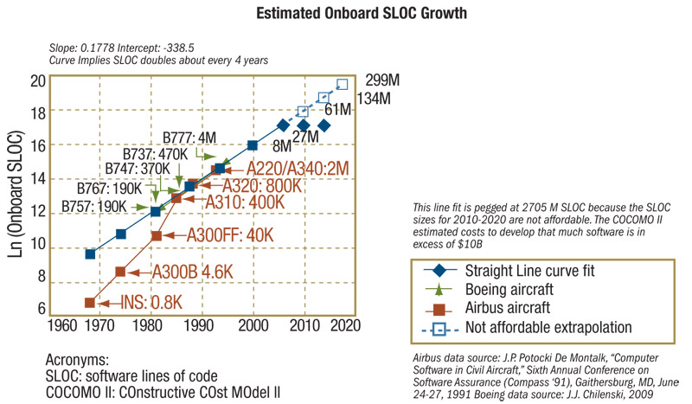
Why is it important?
Source: St Clair, B. Growing Complexity Drives Need for Emerging DO-178C Standard. Nov 2009. http://www.cotsjournalonline.com

Slide 10
Why is it important?
In 1999, NASA lost its $125-million Mars Climate Orbiter because spacecraft engineers failed to convert from English to metric measurements when exchanging vital data before the craft was launched.
Mars Probe Lost Due to Simple Math Error
https://www.popularmechanics.com/space/moon-mars/news/a28632/the-dumb-mistake-that-doomed-a-mars-probe-in-1999/
https://www.simscale.com/blog/2017/12/nasa-mars-climate-orbiter-metric/

Slide 11

A little deeper…
https://www.youtube.com/watch?v=lcYkOh4nweE

Slide 12
Why is it important?
TAM Airlines Flight 3054 (JJ3054/TAM3054) – Congonhas (Brazil)
On the evening of July 17, 2007, the Airbus A320-233 executing the flight overran runway 35L at São Paulo during moderate rain and crashed into a nearby TAM Express warehouse adjacent to a Shell filling station. The plane exploded on impact, killing all 187 passengers and crew on board and 12 people on the ground. The investigation concluded that accident was caused by errors committed by the pilots during the landing at São Paulo.
https://www.bbc.com/news/world-latin-america-23609524
https://www.youtube.com/watch?v=horm8n5CLNk
Notes:
A ideia aqui é que explicar o problema da interpretação incorreta dos comandos pelo piloto e que poderia ter sido evitada em projeto, lembre-se que o ocorreu é que o sistema voltou a atuar contrariando o comando dos pilotos.

Slide 13
However, these accidents were caused by unintentional error on project…

Slide 14
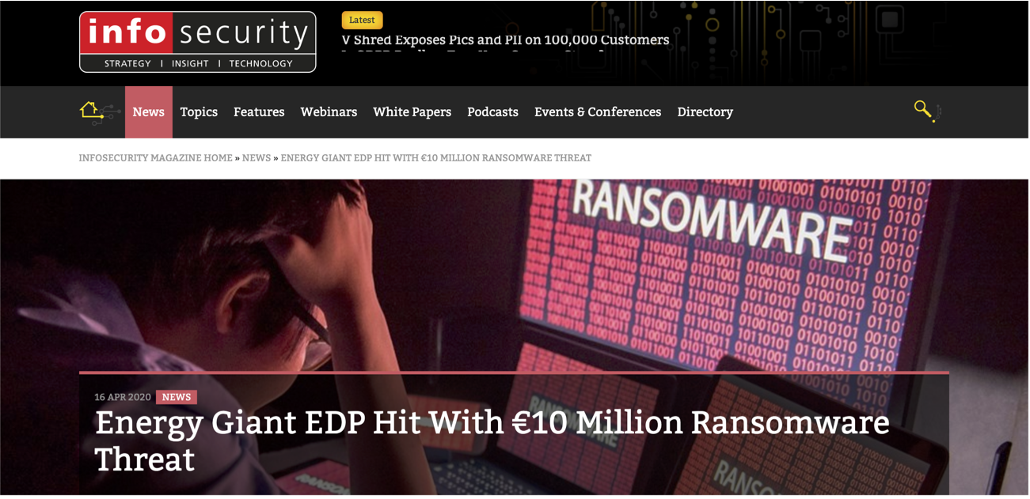
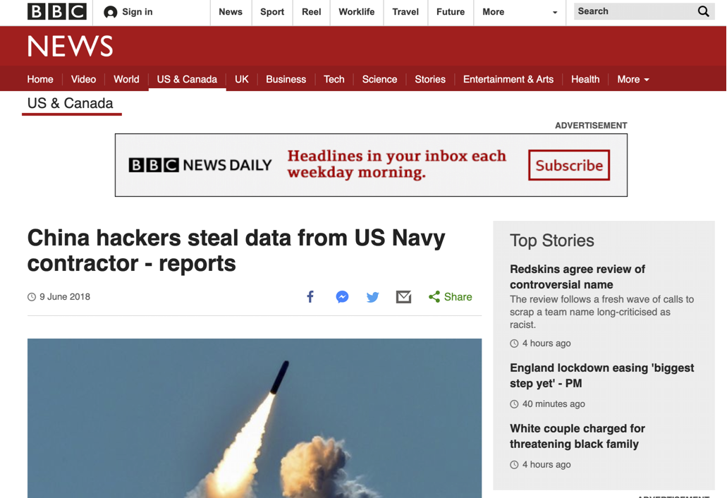
Why is it important?
https://www.bbc.com/news/world-us-canada-44421785
https://www.infosecurity-magazine.com/news/energy-giant-edp-hit-10-million/

Slide 15
Main security concepts

Slide 16
What is cyber security?
“Prevention of damage to, protection of, and restoration of computers, electronic communications systems, electronic communications services, wire communication, and electronic communication, including information contained therein, to ensure its availability, integrity, authentication, confidentiality, and nonrepudiation.”
National Security Presidential Directive 54/Homeland Security Presidential Directive 23 (NSPD- 54/HSPD-23)

Slide 17
Cyber Security Concepts
Asset: Something of value to a person, business, or organization.
“… electronic communications systems, electronic communications services, wire communication, and electronic communication, including information contained therein…”

Slide 18
Cyber Security Concepts
Threat: Something that could cause harm to a system or organization.
Vulnerability: A flaw or weakness that can be used to attack a system or organization.
Exploit: is an attack on a computer system, especially one that takes advantage of a particular vulnerability the system offers to intruders. An exploit takes advantage of a weakness in an operating system, application or any other software code, including application plug-ins or software libraries.

Slide 19
Safety x Security
Traditionally, safety and security have been treated as separate disciplines, with their own regulation, standards, culture, engineering (requirement’s focus).
Safety is concerned with protecting the system's environment, whereas security is concerned with protecting the system from the environment.

Slide 20
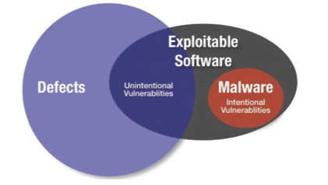
Safety x Security
Security and safety can both be viewed as kinds of dependability (in the sense that each is concerned with mitigating the effects of a kind of failure) and the two disciplines uses similar techniques to identify potential failure modes and assess their impact on the overall system.
Thus, there is considerable overlap between safety and security methods, although the focus is different and in some cases safety and security requirements can be in conflict.
NICHOLS, William Jr R.; SCANLON, Thomas. DoD Developers Guidebook for Software Assurance. Carnegie Mellon University Software Engineering Institute Pittsburgh United States, 2018.

Slide 21
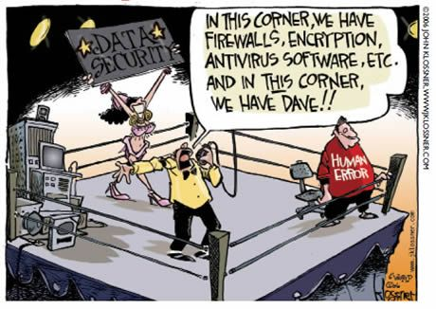
Types of Resilience
Cyber resilience refers to an entity's ability to continuously deliver the intended outcome, despite adverse cyber events¹.
Björck, Fredrik; Henkel, Martin; Stirna, Janis; Zdravkovic, Jelena (2015). Cyber Resilience - Fundamentals for a Definition. Advances in Intelligent Systems and Computing. 353. Stockholm University. pp. 311–316. doi:10.1007/978-3-319-16486-1_31. ISBN 978-3-319-16485-4.

Slide 22
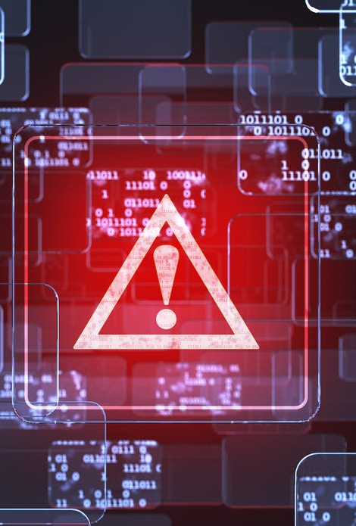
Types of Resilience
It is important for a system to remain safe and secure despite changes to the environment, in other words, to be resilient to change.
We find it useful to distinguish two types of resilience:
Type 1: resilience to design basis threats and events. This could be expressed in the usual terms of fault-tolerance, availability, robustness, etc.
Type 2: resilience to beyond design basis threats, events and use. This might be split into those known threats that are considered incredible or ignored for some reason and other threats that are unknowns.

Slide 23
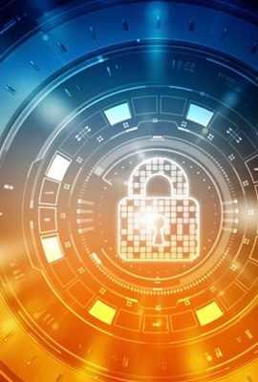
Types of Resilience
Traditional, safety methods address Type 1 resilience, but Type 2 resilience requires a security-informed safety perspective that deals with safety and security concerns in an open and hostile environment in which everything is interconnected, and the threats are continually changing and evolving.

Slide 24
Challenges to Integrate Safety & Security
Concepts and terminology: The commonalities between safety and security are frequently obscured by the use of different concepts and terminologies.
Principles: There are many overlaps between safety and security principles, but there are also some significant differences in emphasis and some potential conflicts.
Methodology: Risk assessment is a fundamental step in safety and security analysis, but the underlying threat model is different.
Security-informed safety cases: Security considerations can have a significant impact on a safety case.
Standards: Safety standards already require “malevolent and unauthorized actions to be considered during hazard and risk analysis”, but the standards framework for dealing with security-informed safety needs to be more explicitly designed than is currently the case.
Notes:
Example of Principles: For example, “defense in depth” is an important architectural principle for both safety and security that depends on the use of multiple, and as far as possible independent, barriers. However, security considerations are likely to challenge the effectiveness and independence of safety barriers.
Security-informed safety cases. Security considerations can have a significant impact on a safety case. For example, there needs to be an impact analysis of the response to security threats and discovery of new vulnerabilities and reduction in the strength of protection mechanism. This suggests a greater emphasis on resilience of the design.

Slide 25
Concepts of Confidentiality, Integrity, and Availability (CIA)

Slide 26
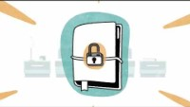

Slide 27
Cyber Security Attributes
Availability: Ensuring timely and reliable access to and use of information. A loss of availability is the disruption of access to or use of information or an information system.
Integrity: Guarding against improper information modification or destruction, including ensuring information nonrepudiation and authenticity. A loss of integrity is the unauthorized modification or destruction of information.
Confidentiality: Preserving authorized restrictions on information access and disclosure, including means for protecting personal privacy and proprietary information. A loss of confidentiality is the unauthorized disclosure of information

Slide 28
Cyber Security Attributes
Authenticity: The property of being genuine and being able to be verified and trusted; confidence in the validity of a transmission, a message, or message.
Nonrepudiation: is the assurance that someone cannot deny something. Typically, nonrepudiation refers to the ability to ensure that a party to a contract or a communication cannot deny the authenticity of their signature on a document or the sending of a message that they originated.

Slide 29
Cyber Security Attributes
Privacy: Assures that individual's control or influence what information related to them may be collected and stored and by whom and to whom that information may be disclosed.

Slide 30
Attack Surface & Attack Tree (Graph)

Slide 31
Exploits Targets
disclosure of data (violation of the confidentiality attribute)
modification of data (violation of the integrity attribute)
insertion of false data (violation of the integrity attribute)
destruction of data (violation of the availability attribute)
interruption of access to data (violation of the availability attribute)
system destruction, destabilization, or degradation (violation of the availability attribute)
Alberts, Christopher & Dorofee, Audrey Managing Information Security Risks: The OCTAVE Approach. Addison-Wesley. 2003.

Slide 32

Attack Surface
Software has errors
Error causes software to behave differently from the intended behavior
Vulnerability is an error that can be exploited by an attacker

Slide 33
Attack Surface
A system’s attack surface is the subset of the system’s resources - methods (e.g., API), channels (e.g., sockets), and data - potentially used in attacks on the system.
Attack Surface of a Connected Vehicle
Manadhata, Pratyusa K., et al. An approach to measuring a system's attack surface. No. CMU-CS-07-146. CARNEGIE-MELLON UNIV PITTSBURGH PA SCHOOL OF COMPUTER SCIENCE, 2007.

Slide 34
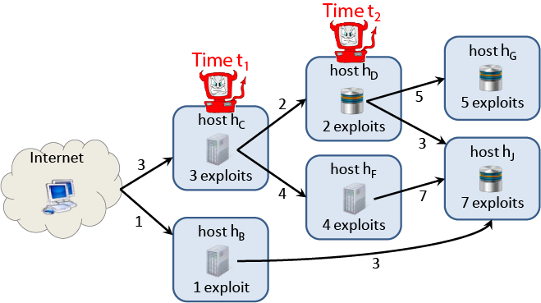
Attack Tree
Attack trees are conceptual diagrams showing how an asset, or target, might be attacked.
Attack trees have been used to describe threats on computer systems and possible attacks to realize those threats.
They are widely used in the fields of defense and aerospace for the analysis of threats against tamper resistant electronics systems (e.g., avionics on military aircraft).
Attack trees have also been used to understand threats to physical systems.

Slide 35
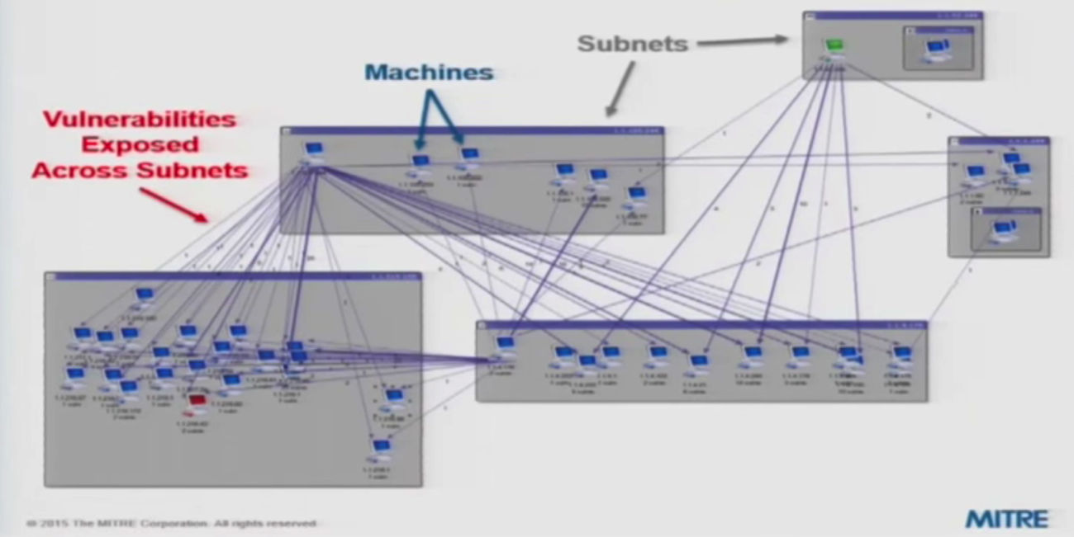
Attack Graph

Slide 36
Security Design Principals

Slide 37
Security Design Principles
The security design principles are considered while designing any security mechanism for a system.
These principles are reviewed to develop a secure system which prevents the security flaws and prevents unwanted access to the system.

Slide 38
Security Design Principles
Least Privilege
Fail-Safe Defaults
Economy of Mechanism
Complete Mediation
Open Design
Separation Privilege
Least Common Mechanism
Psychological Acceptability
Defense in Depth

Slide 39

Least Privilege
The Least Privilege design principle requires a minimalistic approach to granting user access rights to specific information and tools.
Additionally, access rights should be time based as to limit resources access bound to the time needed to complete necessary tasks.
The implications of granting access beyond this scope will allow for unnecessary access and the potential for data to be updated out of the approved context.
This principle attempts to limit data changes and prevents potential damage from occurring by accident or error by reducing the amount of potential interactions with a resource.

Slide 40
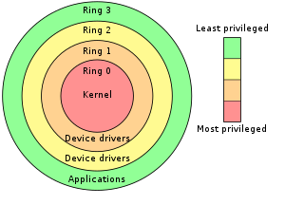
Least Privilege
Intel x86 Architecture

Slide 41

Fail-Safe Defaults
The Fail-Safe Defaults design principle pertains to allowing access to resources based on granted access over access exclusion.
This principle is a methodology for allowing resources to be accessed only if explicit access is granted to a user.
By default, users do not have access to any resources until access has been granted.
This approach prevents unauthorized users from gaining access to resource until access is given.

Slide 42
Economy of Mechanism
The Economy of mechanism design principle requires that systems should be designed as simple and small as possible.
Design and implementation errors result in unauthorized access to resources that would not be noticed during normal use.
So more the design is simple less are the opportunities for the tester to discover the flaws and more the complex is the design more are the chances to exploit flaws in the design.

Slide 43
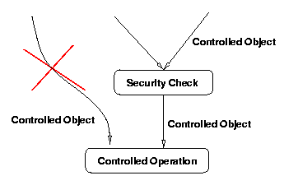
Complete Mediation
The Complete Mediation design principle states that every access to every resource must be validated for authorization.

Slide 44
Open Design
This security principle suggests that the security mechanism design should be open to the public.
Like in the cryptographic algorithm, the encryption key is kept secret while the encryption algorithm is opened for a public investigation.
This principle is followed by the NIST (National Institute of Standards and Technology) to standardize the algorithms because it helps in worldwide adoption of NIST approved algorithms.

Slide 45
Separation Privilege
Separation of privilege is an information technology best practice applied by organizations to broadly separate users and processes based on different levels of trust, needs, and privilege requirements.
Separation of privilege, also called privilege separation, refers to both the:
Segmentation of user privileges across various, separate users and accounts
Compartmentalization of privileges across various application or system sub-components, tasks, and processes.

Slide 46
Separation Privilege
Separation of privilege can be implemented in a number of ways, but some common examples include:
Separating various administrative account functions from each other
Separating administrative and standard account capabilities
Separating auditing and logging capabilities within administrative accounts
Separating system functions like read, edit, write, execute, etc.

Slide 47
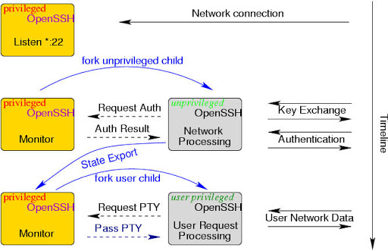
Separation Privilege

Slide 48
Least Common Mechanism
Following the least common mechanism, a security design principle there should be minimum common functions to share between the different user.
This principle reduces the count of communication paths and therefore further reduces the hardware and software implementation.
Ultimately this principle reduces the threat of unwanted access to the system as it becomes easy to verify if there are some unwanted accesses to the shared function.

Slide 49
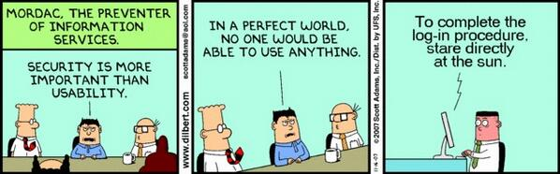
Psychological Acceptability
This security design principle says that the security mechanisms design to protect the system should not interfere with the working of the user every now and then.

Slide 50
Defense in Depth
The Defense in Depth design principle is a concept of layering resource access authorization verification in a system reduces the chance of a successful attack.
This layered approach to resource authorization requires unauthorized users to circumvent each authorization attempt to gain access to a resource.
When designing a system that requires meeting a security quality attribute architects need consider the scope of security needs and the minimum required security qualities.

Slide 51
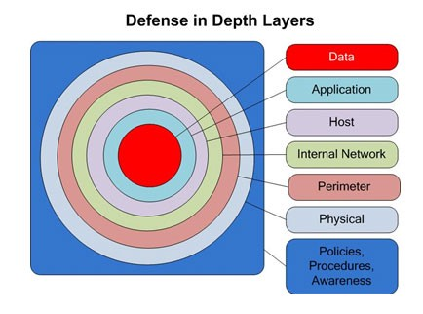
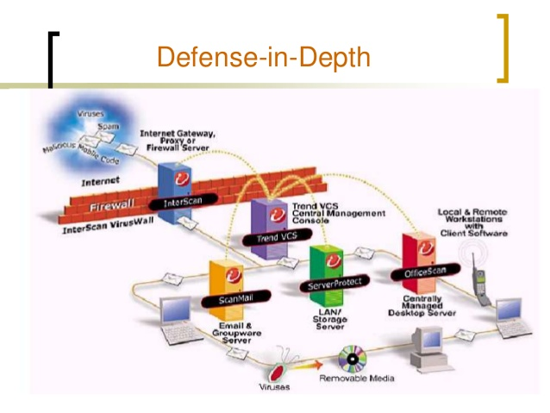
Defense in Depth

Slide 52
Risk Management Foundations

Slide 53
Risk Management
Risk Management
Identify
Analyze
Action
Monitor
Control
Risk management is the identification, evaluation, and prioritization of risks (effect of uncertainty on objectives) followed by coordinated and economical application of resources to minimize, monitor, and control the probability or impact of unfortunate events or to maximize the realization of opportunities.
ISO/IEC Guide 73:2009 (2009). Risk management — Vocabulary. International Organization for Standardization.

Slide 54
Risk Components and Measures
Uncertainty, which can be measured via probabilities, is involved in all components.
Can you give examples of each?
A more elaborate analysis must consider them all.
Probabilities would be mostly conditional, requiring a more careful analysis.
CONDITION
(passive element)
POTENTIAL EVENT
PROBABILITY
CONSEQUENCE
(loss)
Risk Management is a systematic approach for minimizing exposure to potential losses.
EXPOSURE
IMPACT
TIME FRAME

Slide 55
From a Cyber Perspective….
VULNERABILITY
THREAT
EXPLOIT
CONDITION
(passive element)
POTENTIAL EVENT
CONSEQUENCE
(loss)

Slide 56
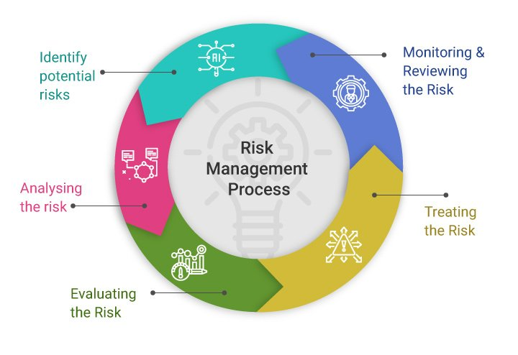
Risk Management Process

Slide 57
Why Preventive Measures is not enough
Inherent weaknesses in increasingly more complex systems/networks
Poor Design (Software and hardware)
Example: sendmail (race condition vulnerability, buffer overflow, group permission vulnerability, etc.)
Poor Implementation
Security an afterthought
Lack of personnel experience/training
Poor system configuration
Example: default firewall configurations with open insecure ports

Slide 58
Why Preventive Measures is not enough
Poor Management: Inadequate policies/procedures
Tradeoff between security and usability
Non-tech tradeoffs in system engineering
social, organizational, economic, regulatory, legal
Cost of prevention

Slide 59

Attack Categories
Probe
Information gathering (1:1, 1:m, m:1, m:n modes)
IPSweep, portsweep, nmap, etc.
Denial of Service (DoS)
TCP SYN flood, Ping of Death, smurf, neptune, etc.
Remote to Local attacks (R2L)
Brute force/Dictionary attack, buffer overflow, unverified input attacks
Social engineering, Trojans
User to Root attacks (U2R)
Buffer overflow, rootkit, etc.
Infections
Trojans/worms/viruses
Spreading attacks

Slide 60

Basic Attack Steps
Prepare
Gather info: Valid IP addresses & ports, OS, software type & version
Exploit
Leave behind (Backdoors)
Clean up
Restart crashed daemons, clean registry/log files
Variable order and duration
Attacker’s skill level
Type of vulnerability to exploit
Prior knowledge
Starting location of attacker

Slide 61
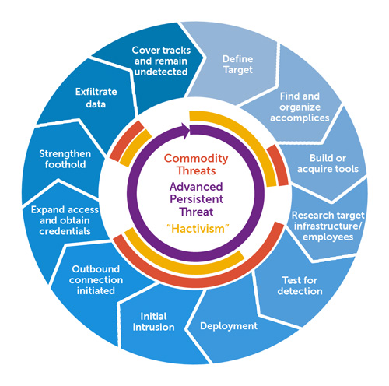
Advanced Persistence Threats (APT)
Targeted attack against a high-value asset
Low and slow
Avoid alerts
Use stolen user credentials
Zero-day exploits
Low profile in network
Slow progress: Operating over months or years
Beyond limited correlation time windows of today’s IDSs
Multi-stage
Exploitation
Command and control
Lateral movement
Breach

Slide 62
Advanced Persistence Threats (APT)
Typical Goals
Steal intellectual property (IP)
Gain access to sensitive customer data
Access strategic business information
Financial gain, embarrassment, blackmail, data poisoning, illegal insider trading, disrupting organization’s business
Attackers
Well-funded
Highly skilled
Motivated
Targeted on specific data from specific organization

Slide 63
Failure to prevention
Source: St Clair, B. Growing Complexity Drives Need for Emerging DO-178C Standard. Nov 2009. http://www.cotsjournalonline.com

Slide 64
Failure to prevention
Attack mechanisms constantly evolving/ mutating
New connectivity options bypassing perimeter security
Preventive measures getting obsolete
Polymorphic viruses resistant to current antivirus

Slide 65
Defense Security
1st Generation: Intrusion detection systems (IDS)
100% protection/prevention impossible
Layered security
2nd Generation: Security information and event management (SIEM)
Correlate alerts from different intrusion detection sensors
Present actionable information to security analyst
3rd Generation: Big Data analytics for security
Contextual security intelligence
Long-term correlations

Slide 66
Unit 1 - Cyber Security Foundation
Goals
Why we need computer security?
Main security concepts
Concepts of Confidentiality, Integrity, and Availability (CIA)
Attack Surface & Attack Tree (Graph)
Security Design Principals
Risk Management Foundations

Slide 67
Computer and Information Security (TC2027)

